Slide 1
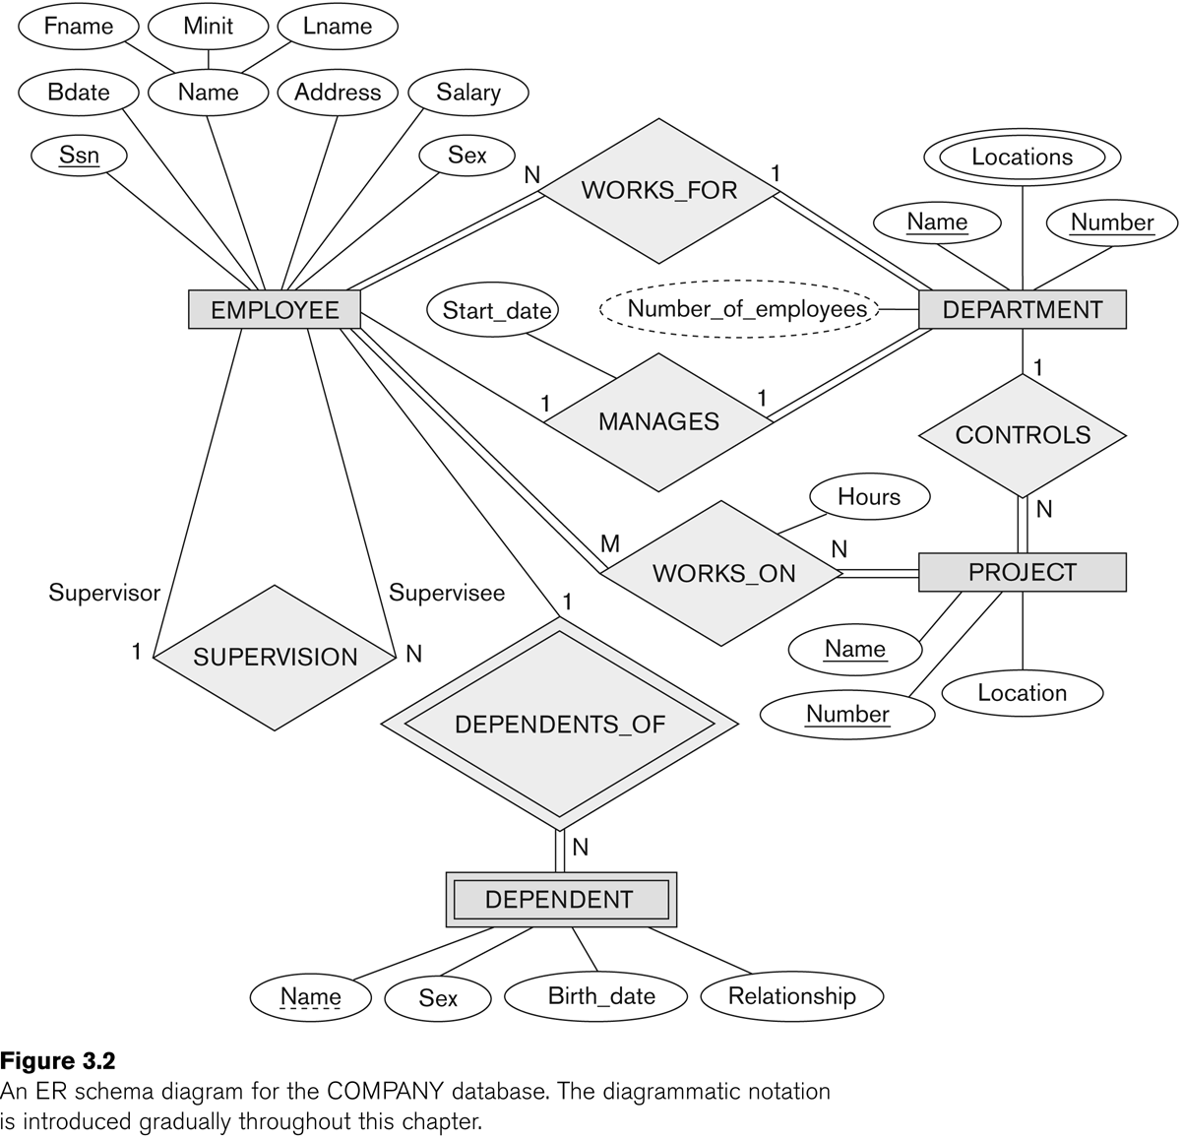
ER (Entity Relationship) Diagram in Chen Notations
References
Modeling Using the Entity–Relationship (ER) Model (chapter 3, Fundamentals of Database Systems by Elmasri)
https://vertabelo.com/blog/chen-erd-notation

Slide 2
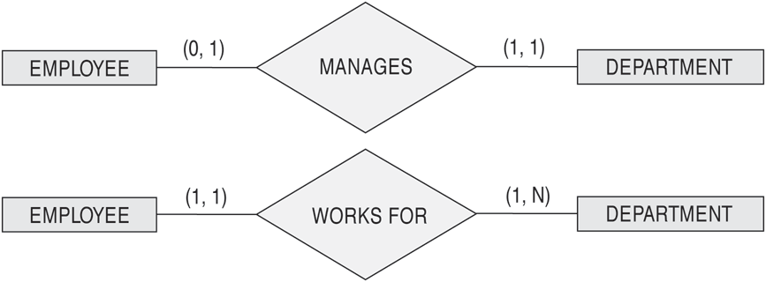
(min,max) notation
Read the min,max numbers next to the entity type and
looking away from the entity type

Slide 3
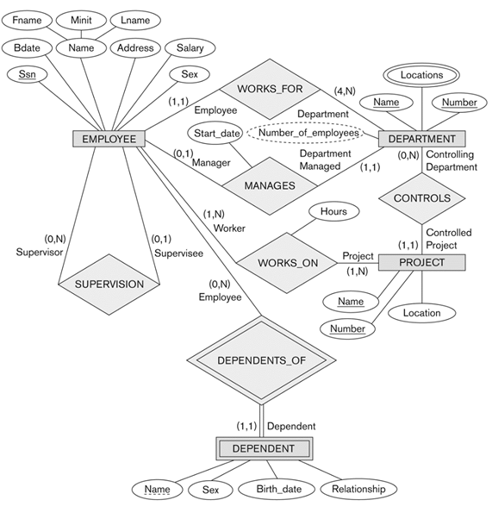
ER Diagram for company using min-max notation and role names

Slide 4
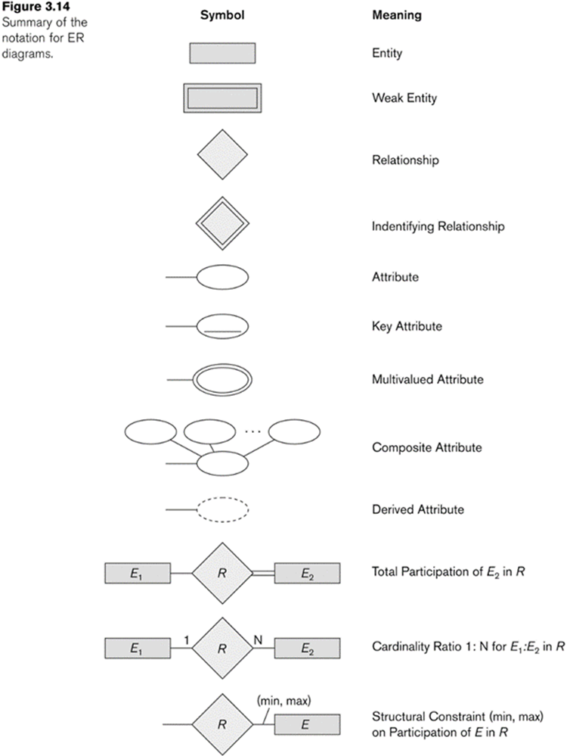
Summary of Chen notation for ERD

Slide 5
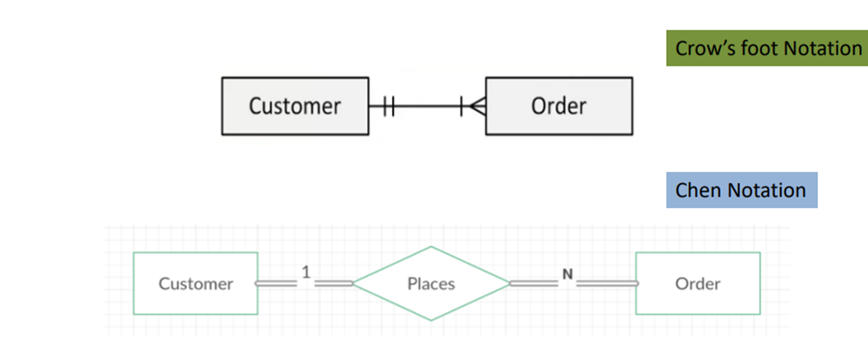
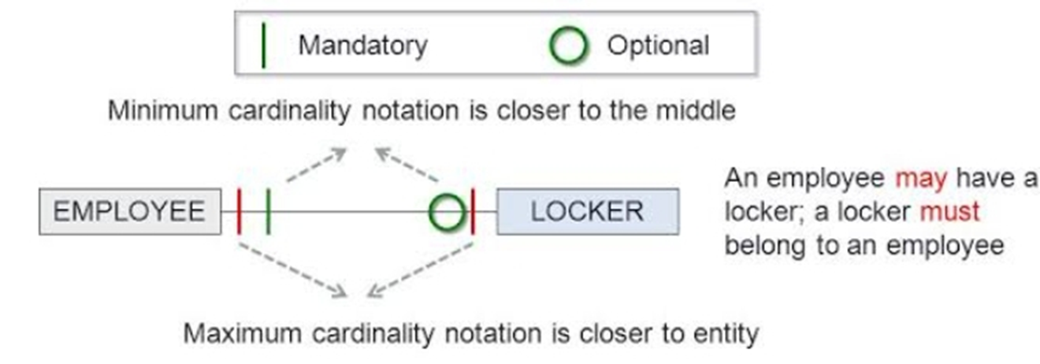
Maximum and Minimum cardinalities
Maximum cardinality from ORDER to CUSTOMER is one.
Minimum cardinality from ORDER to CUSTOMER is one.
Maximum cardinality from CUSTOMER to Order is Many.
Minimum cardinality from CUSTOMER to Order is one.

Slide 6
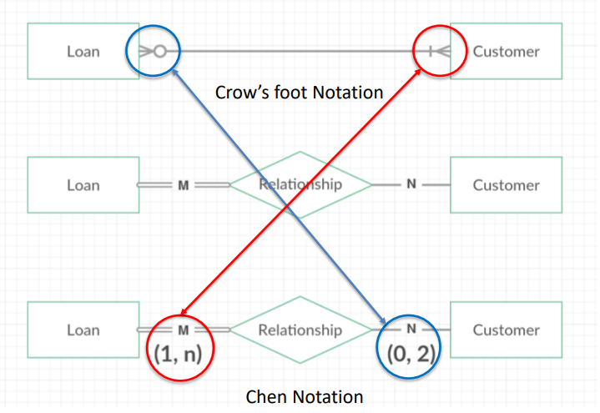
Comparison of Crow’s foot and Chen notations

Slide 7
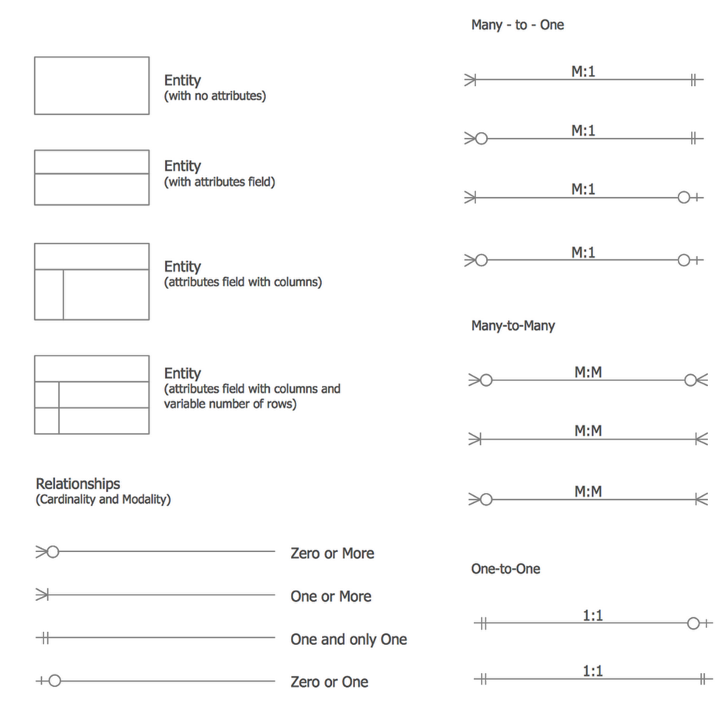
Crow’s foot Notation

Slide 8
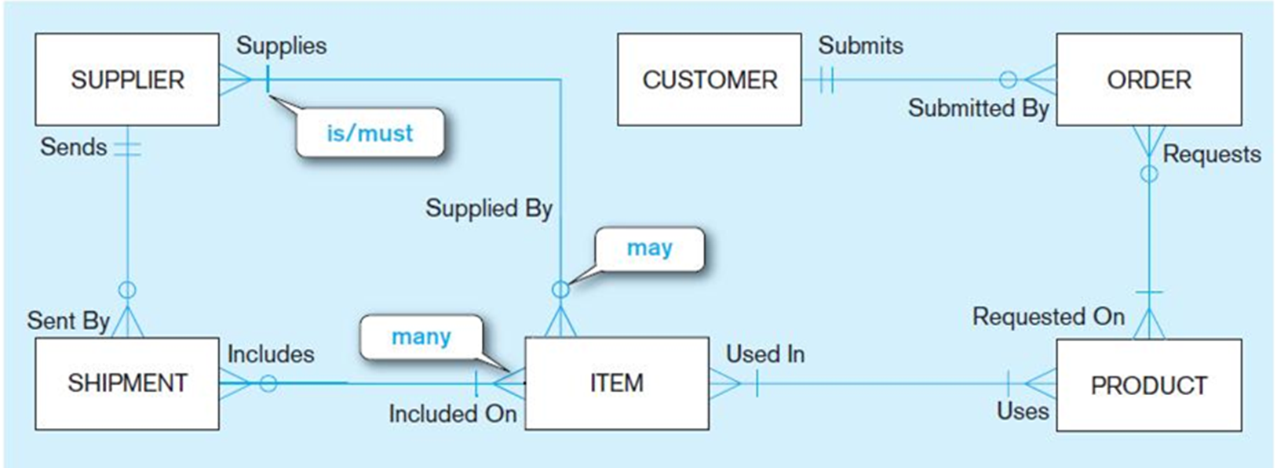
Crow’s foot Notation Example

